Slide 1
Deep Learning for Sequential Data
Models and applications

Slide 2
Outline
Sequence Data
Recurrent Neural Networks Variants
Handling Long Term Dependencies
Attention Mechanisms
Properties of RNNs
Applications of RNNs
Hands-on LSTM-supported timeseries prediction

Slide 3
Sequential Data
Sequence data is any data where the order matters
text data
protein/gene sequences
sequential patterns: e.g., sequences of purchases
timeseries
stock prices
amount of precipitation
ECG data
music
audio data
trajectories
video

Slide 4
Formal Definition
A sequence of length n is a mapping of an index set I_{n} = {1, 2,..., n} into a domain O:
S : I_{n} → O
The index values are discreet
The sequences is classified by its domain O:
categorical values (nominal values, alphabets, enumeration types)
continuous values (real numbers)

Slide 5
Recurrent Neural Networks¹
Recurrent neural networks (RNNs) are a family of neural networks for processing sequential data:
they can scale to much longer sequences than would be practical for networks without sequence-aware units
most recurrent networks can process sequences of variable length

Slide 6
Recurrent Neural Networks²
RNNs allow previous outputs to be used as inputs while also having hidden units. A high-level RNN architecture is as follows:
For each timestep t, the hidden state h^{<t>} and the output y^{<t>} are as follows:
h^{<t>} = g₁(W_{hh}h^{<t-1>} + W_{hx}x^{<t>} + b_{h}) and y^{<t>} = g₂(W_{yh}h^{<t>} + b_{y})
h^{<0>}
h^{< t-1 >}
h^{< t >}
h^{< t+1 >}

Slide 7
Recurrent Neural Networks¹
Hidden state
the RNN learns to use the hidden state as a summary of the task-relevant aspects of the past
this summary is usually lossy because it maps an arbitrary length sequence (x^{<t>}, x^{<t-1>}, x^{<t-2>},…. , x^{<2>}, x^{<1>}) to a fixed length vector h^{<t>}

Slide 8
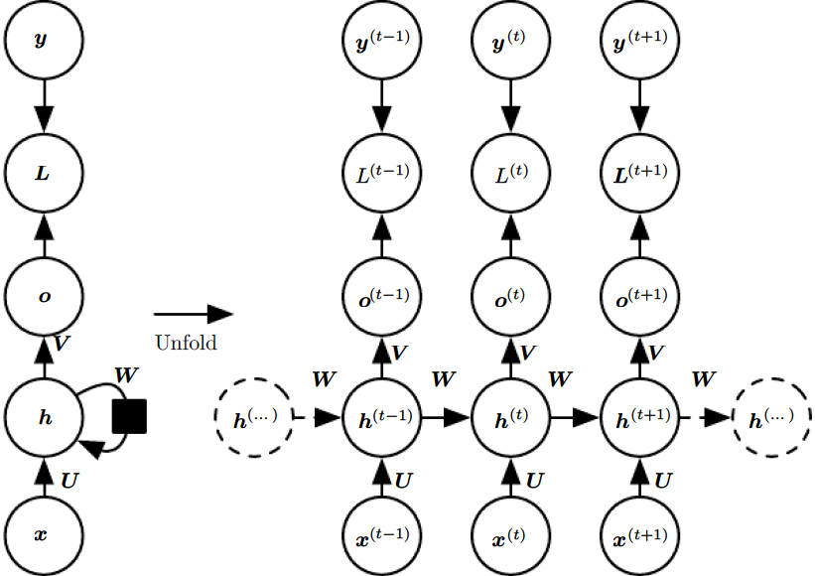
RNN Variants¹
RNNs that produce an output at each time step and have recurrent connections between hidden units (Turing complete):

Slide 9
RNN Variants¹
RNNs that produce an output at each time step and have recurrent connections between hidden units (Turing complete):
They map an input sequence to an output sequence of the same size

Slide 10
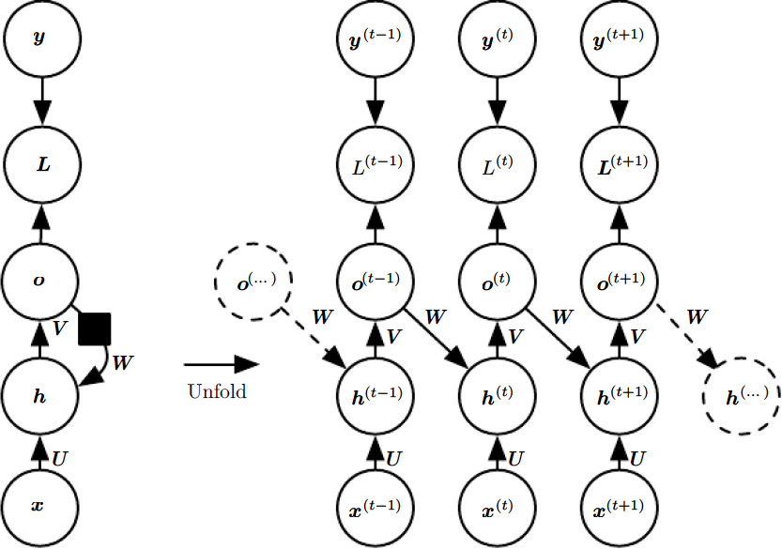
RNN Variants¹
RNNs that produce an output at each time step and have recurrent connections only from the output of one step to the hidden unites in the next step:
Notes:
May be trained with teacher forcing

Slide 11
RNN Variants¹
RNNs that produce an output at each time step and have recurrent connections only from the output of one step to the hidden unites in the next step:
Less powerful but easier to train
Notes:
May be trained with teacher forcing

Slide 12
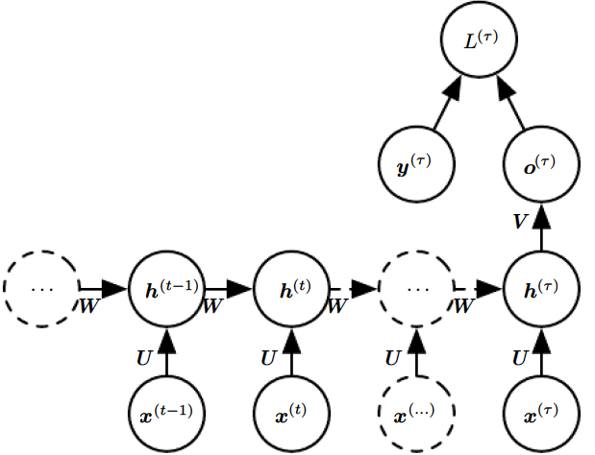
RNN Variants¹
RNNs with recurrent connections between hidden units that read an entire sequence and then produce a single output:
Can be used to summarize a sequence and produce a fixed-size representation used as input for further processing

Slide 13
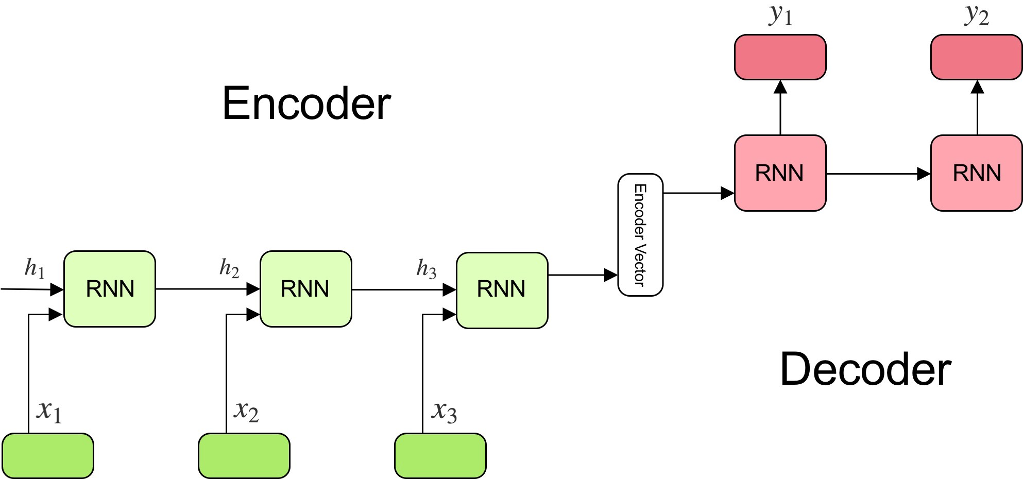
Encoder-Decoder Sequence-to Sequence Architectures^{1,4}
A sequence to sequence (Seq2Seq)^{15,16} model aims to map a fixed-length input with a fixed-length output where the length of the input and output may differ.
Context

Slide 14
Encoder-Decoder Sequence-to Sequence Architectures^{1,4}
A sequence to sequence (Seq2Seq)^{15,16} model aims to map a fixed-length input with a fixed-length output where the length of the input and output may differ.
Encoder: processes the input sequence (ordinary sequence-to-vector RNN)
Context: output of the encoder
is usually a simple function of its final hidden state
aims to encapsulate the information for all input elements in order to help the decoder make accurate predictions
Decoder: is conditioned on the context to generate the output sequence
the context acts as the initial hidden state of the decoder part of the model
produces output at each step

Slide 15
Bidirectional RNNs¹
In many applications we want to output a prediction y^{<t>} which may depend on the whole sequence as opposed to values for T <= t
handwriting recognition: the correct interpretation of the current sound as a phoneme may depend on the next few phonemes because of co-articulation and potentially may even depend on the next few words because of the linguistic dependencies between nearby words
machine translation: we often require future context to interpret what is being said. In other words, sometimes we don’t understand a sentence until an important word or phrase is provided at the end
named entity resolution: Paris Hilton vs. Paris Opera
(secondary) protein structure prediction: in beta-sheets stabilizing bonds can be formed between amino acids far apart on both directions

Slide 16
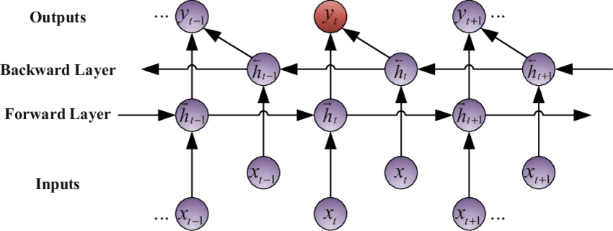
Bidirectional RNNs^{1,3}
They usually consist of two RNNs run in parallel that connect to the same output

Slide 17
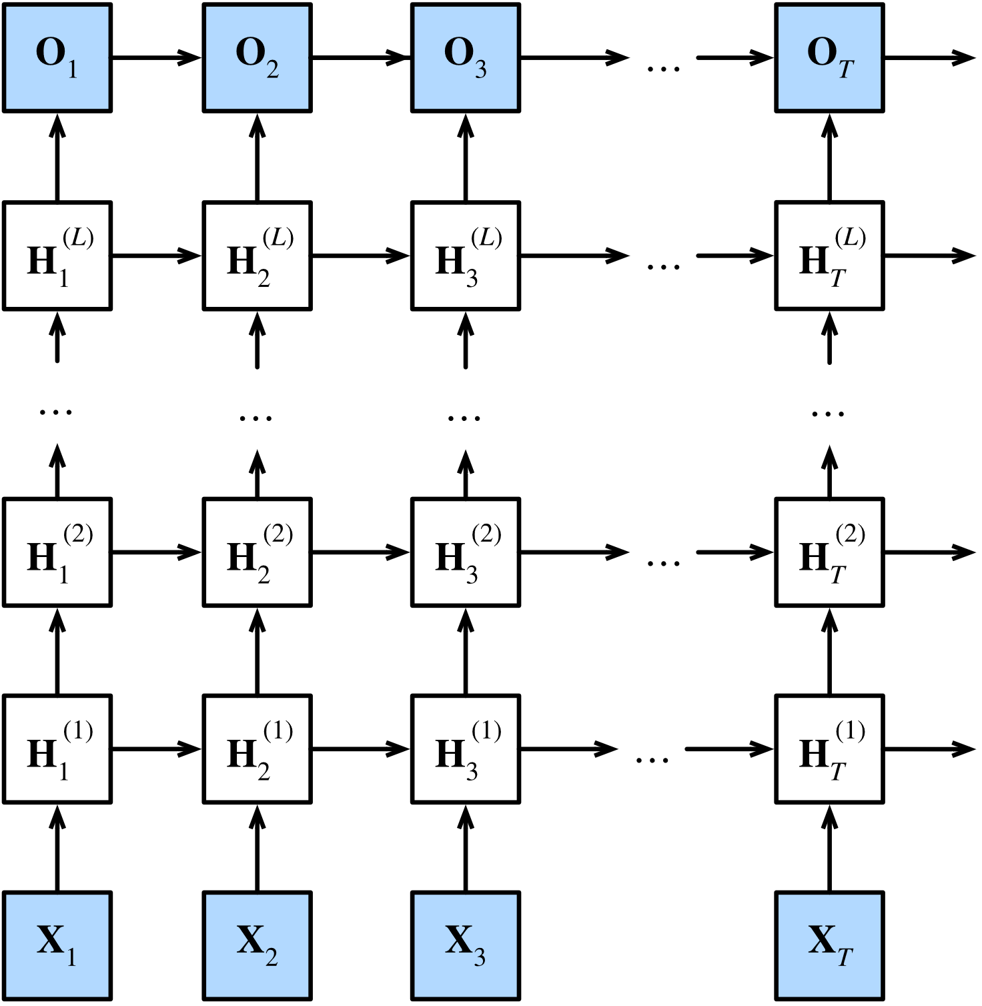
Deep RNNs^{1,5}
There are various ways to add ‘depth’ in RNNs, each with its advantages. Most frequently several hidden layers are stacked on top of each other.

Slide 18
Handling Long Term Dependecies¹
RNNs learn the dependencies of the current output with the past/future values of the input
However, for tasks with long term dependencies (t_{past} << t_{current}, t_{future} >> t_{current}) gradient descend fails⁶
small gradients tend to vanish
large gradients tend to explode
Several RNN variants have been proposed to mitigate the issue:
LSTM networks
GRU networks

Slide 19
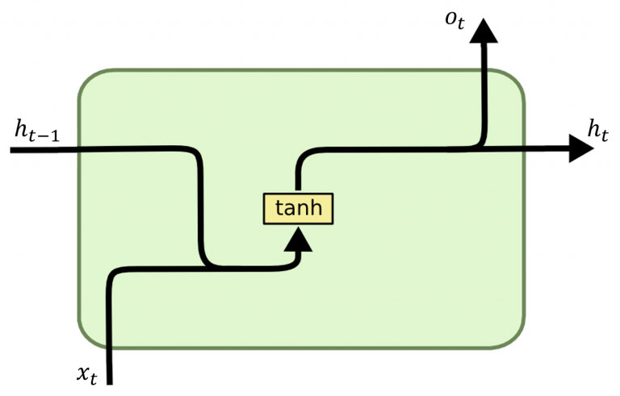
Handling Long Term Dependecies^{1,7}
LSTM and GRUs employ gated units that allow the network to accumulate information over time and discard it once it is not needed anymore:
Vanilla RNN
Notes:
A gate in a neural network acts as a threshold for helping the network to distinguish when to use normal stacked layers versus an identity connection. An identity connection uses the output of lower layers as an addition to the output of consecutive layers. In short, it allows for the layers of the network to learn in increments, rather than creating transformations from scratch. The gate in the neural network is used to decide whether the network can use the shortened identity connections, or if it will need to use the stacked layers.

Slide 20
Handling Long Term Dependecies^{1,9}
LSTM and GRUs employ gated units that allow the network to accumulate information over time and discard it once it is not needed anymore:
o_{t}
o_{t}

Slide 21
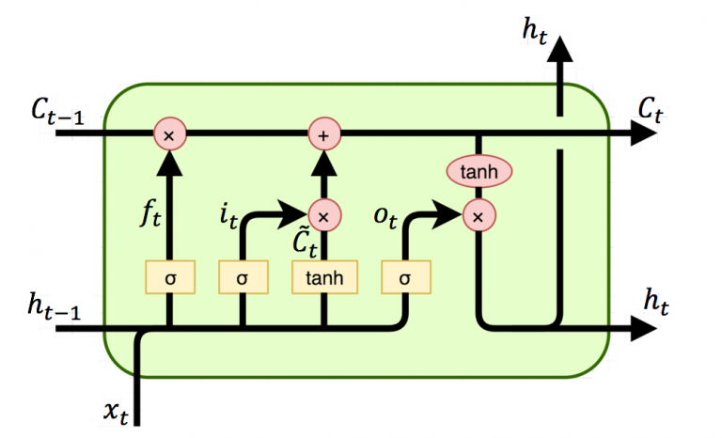
LSTM^{1,7,8}
An internal cell state is maintaining the global information at each time
LSTM
o_{t}

Slide 22
LSTM^{1,7,8}
The forget gate is used to remove irrelevant information from the cell state as new input is encountered
f_{t} = σ (W_{f} * [h_{t-1}, x_{t}] + b_{f}
o_{t}
Notes:
The sigmoid output zero for the units to forget and 1 for the units to retain

Slide 23
LSTM^{1,7,8}
The input logic adds new information in the cell state
i_{t} = σ (W_{i} * [h_{t-1}, x_{t}] + b_{i} ← decides which values to retain
C_{t} = tanh (W_{c} * [h_{t-1} , x_{t}] + b_{c} ← new candidate values
C_{t} = f_{t} Ꙩ C_{t-1} + C_{t} Ꙩ i_{t}
o_{t}
~
~
Notes:
Ꙩ → point wise multiplication

Slide 24
LSTM^{1,7,8}
The output gate computes the new hidden state based on the updated cell state and the output
o_{t} = σ (W_{o} * [h_{t-1} , x_{t}] + b_{o}
h_{t} = o_{t} Ꙩ tanh(C_{t})
o_{t}

Slide 25
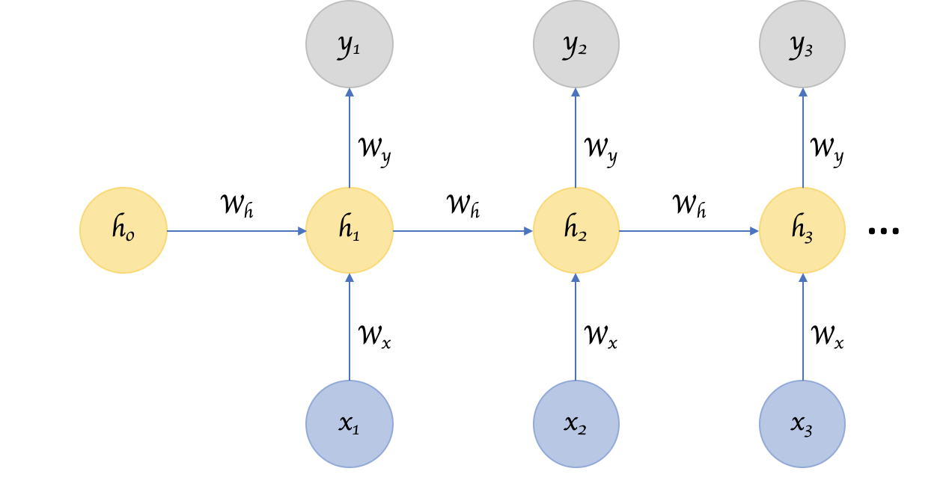
Attention Mechanisms in Recurrent Neural Netowrks¹⁰
The basic premise of a vanilla RNN is to parse every item in an input series, one after the other, and keep updating its hidden state. This hidden state vector at the end of every step represents the context of all prior inputs. So, the last hidden state represents the context of the entire sequence.

Slide 26
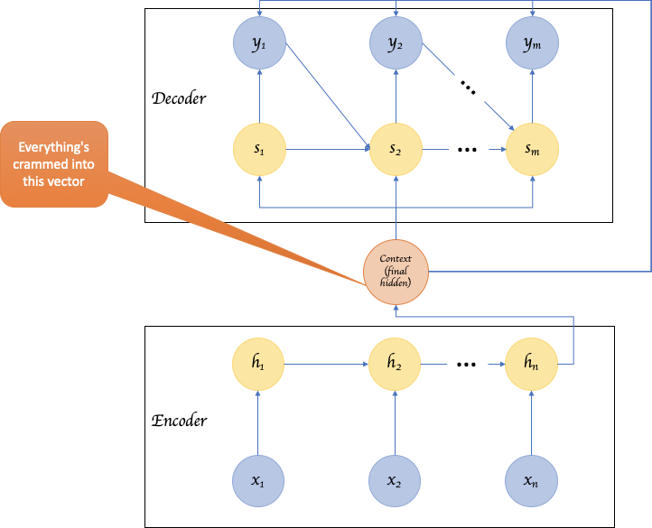
Attention Mechanisms in Recurrent Neural Netowrks¹⁰
The longer the input sequence the more difficult is for the hidden vector to capture the context^{11,12}

Slide 27
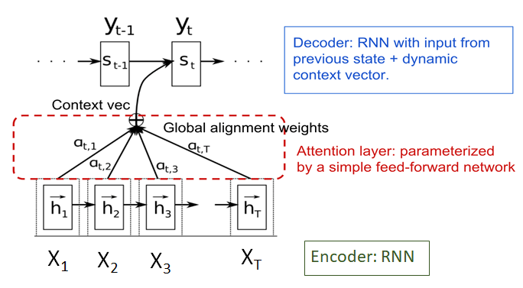
Attention Mechanisms in Recurrent Neural Netowrks¹⁰
create shortcuts between the context vector and the entire source input
the weights of these connections are customizable for each output element

Slide 28
Attention Mechanisms in Recurrent Neural Netowrks¹⁰
Attention pertaining to decoder cell i
ENCODER
x₁
x₂
x₃
x₄
x_{n}
h₀
h₁
h₂
h₃
…..
cell
cell
cell
cell
cell
h₁
h₂
h₃
h₄
h₅
Dense
Dense
Dense
Dense
Dense
1
e_{i1}
e_{i2}
e_{i3}
e_{i4}
e_{in}
softmax
2
α_{i1}
α_{i2}
α_{i3}
α_{i4}
α_{in}
X
X
X
X
X
3
+
c_{i}
s_{i - 1}
s_{i}
cell
y_{i - 1}

Slide 29
Attention Mechanisms in Recurrent Neural Netowrks¹⁰
Attention pertaining to decoder cell i
e_{ij} = tanh(W *h_{j} + U *s_{i-1})
a_{ij} = [softmax(e_{i})]_{j} = $\frac{exp⁡(eij)}{\sum_{k}{exp⁡(eik)}}$
c_{i} = $\sum_{j}{aij ∗hj}$
1
2
3

Slide 30
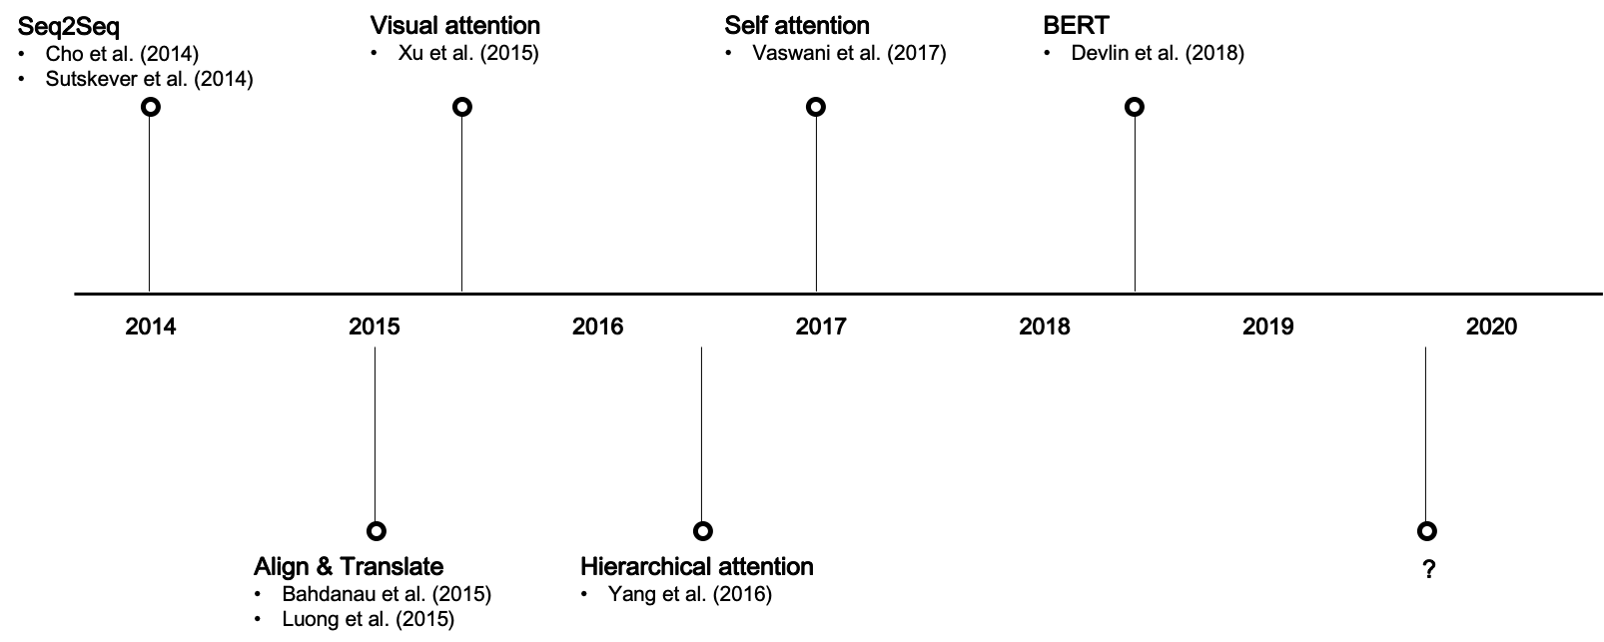
Key Development in Attention Mechanism¹⁰
Seq2Seq ^{[15,16]}
Visual Attention ^{[18]}
Transformer ^{[20]}
Bert ^{[21],} GTP ^{[25]}
Align & Translate ^{[13,17]}
Hierarchical Attention ^{[19]}
T5 ^{[24]} ?

Slide 31
Properties of RNNs²
Possibility of processing input of any length
Model size not increasing with size of input
Computation considers historical information
Weights are shared across time
makes it possible to extend and apply the model to sequences of different lengths
can identify relevant information irrespective of is position in the sequence
Computation being slow
Difficulty of accessing information from a long time ago
Attention mechanisms can considerably alleviate that
Cannot in general consider any future input for the current state

Slide 32
Applications of RNNs
Text Generation
Text Summarization
Report Generation
Timeseries anomaly detection
Speech Recognition
Call Center Analysis
Handwriting Recognition
Music composition
Grammar Learning

Slide 33
Applications of RNNs
Sequence Prediction/Forecasting
Conversational Interfaces and chatbots
Machine Translation
Visual Search, Face detection, OCR Applications
Semantic Search
Sentiment Analysis
Human action recognition
Protein Homology Detection

Slide 34
Alternatives to RNNs
CNNs^{[23]}
Have recently shown to performs comparatively with RNNs
Usually run much faster
Attention based models^{[20]}
BERT variants
T5^{[24]}
GTP-xx autoregressive family of models^{[25]}

Slide 35
References
I. GoodFellow, Y. Bengio, A. Courniville: Deep Learning (Adaptive Computation and Machine Learning series), 2016
https://stanford.edu/~shervine/teaching/cs-230/cheatsheet-recurrent-neural-networks
https://www.researchgate.net/figure/Bidirectional-recurrent-neural-networks-BRNNs_fig3_282530613
https://towardsdatascience.com/understanding-encoder-decoder-sequence-to-sequence-model-679e04af4346
https://d2l.ai/chapter_recurrent-modern/deep-rnn.html
Y. Bengio, P. Simard, P. Frasconi: Learning Long-Term Dependencies with Gradient Descend is Difficult, IEET Transaction on Neural Networks, 1994
http://dprogrammer.org/rnn-lstm-gru
https://medium.com/@ashish.cse16/understanding-the-flow-of-information-through-lstm-cell-4b8eee2c4c9d
https://github.com/roomylee/rnn-text-classification-tf
https://towardsdatascience.com/an-introduction-to-attention-transformers-and-bert-part-1-da0e838c7cda
K. Cho, B. van Merriënboer, D. Bahdanau and Y. Bengio: On the Properties of Neural Machine Translation: Encoder–Decoder Approaches, Workshop on Syntax, Semantics and Structure in Statistical Translation, 2014
P. Koehn and R. Knowles: Six Challenges for Neural Machine Translation, Workshop on Neural Machine Translation, 2017
D. Bahdanau, K. Cho and Y. Bengio: Neural Machine Translation by Jointly Learning to Align and Translate, ICLR 2015
https://buomsoo-kim.github.io/attention/2020/01/01/Attention-mechanism-1.md/
K. Cho, D. Bahdanau, F. Bougares, H. Schwenk and Y. Bengio: Learning Phrase Representations using RNN Encoder–Decoder for Statistical Machine Translation, EMNLP 2014
I. Sutskever, O. Vinyals and Q. V. Le: Sequence to Sequence Learning with Neural Networks, NIPS 2014
M.-T. Luong, H. Pham and C. D. Manning: Effective Approaches to Attention-based Neural Machine Translation, EMNL 2015
K. Xu, J. L. Ba, R. Kiros, K. Cho, A. Courville, R. Salakhutdinov, R. S. Zemel and Y. Bengio: Show, Attend and Tell: Neural Image CaptionGeneration with Visual Attention, PMLR, 2015
Z. Yang, D. Yang, C. Dyer, X. He, A. Smola and E Hovy: Hierarchical Attention Networks for Document Classification, NAACL-HLT 2016
A. Vaswani, N. Shazeer, N. Parmar, J. Uszkoreit, L. Jones, A. N. Gomez, Łukasz Kaiser and I. Plosukhin: Attention is All You Need: NIPS 2017
J. Devlin, M.-W. Chang, K. Lee and Kristina Toutanova: BERT: Pre-training of Deep Bidirectional Transformers for Language Understanding, NAACL 2019
D. Foster: Generative Deep Learning: Teaching Machines to Paint, Write, Compose and Play, O’REILLY 2019
H. Weytjens and J. De Weerdt: Process Outcome Prediction:CNN vs. LSTM (with Attention): arXiv:2104.06934, 2021
C. Raffel, N. Shazeer, A. Roberts, K. Lee, S. Narang, M. Matena, Y. Zhou, W. Li, Peter J. Liu: Exploring the Limits of Transfer Learning with a Unified Text-to-Text Transformer: J. Mach. Learn. Res. 21: 140:1-140:67 (2020)
T. B. Brown el al: Language Models are Few-Shot Learners: NeurIPS 2020

Slide 36
Hands-on LSTM-supported timeseries prediction
https://bitbucket.org/diip20201/tutorials/src/master/sequencial_data_dl/

