Slide 1
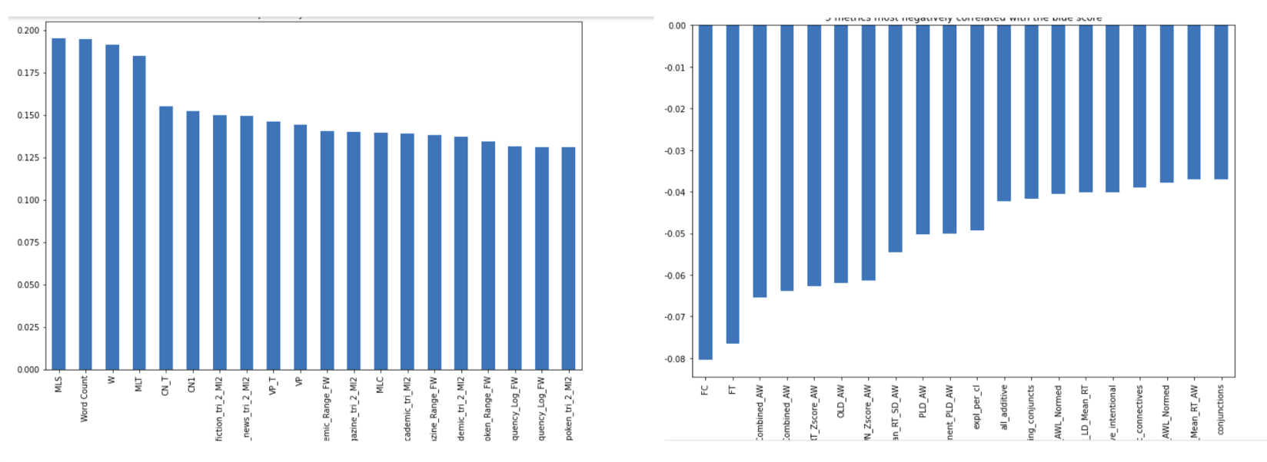
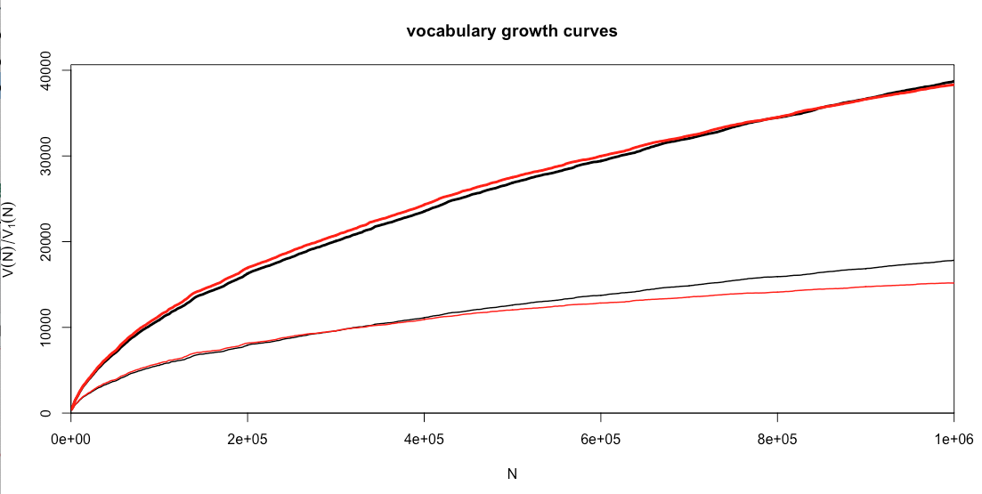
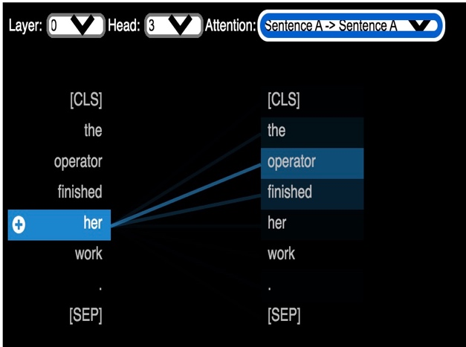
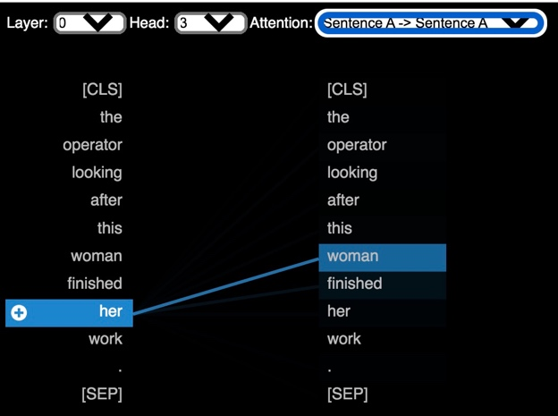

ComplexNeuroViz : Complexity Visualisation
for Neural Machine Translation
Nicolas Ballier (CLILLAC-ARP), Guillaume Wisniewski (LLF), Jean-Baptiste Yunès (IRIF),
Bilal Faye & Zong-You Ke (trainees), Université de Paris
Contact: nicolas.ballier@u-paris.fr, zongyou.ke.fr@gmail.com
Research question
Improve translation quality with complexity measurements and visualisations of attention matrices.
Results
Identified top complexity metrics factors that are positively or negatively correlated with BLEU scores.
Pre-processing stage is a game changer for linguistic expertise, and may develop into novel approaches for complexity.
Sentence complexification causes shifts in attention weight distribution and coreference translation accuracy.
Proposed solutions
Perform sanity check on how linguistic complexity deteriorates BLEU scores.
Study how corpus size impacts sub-tokenisation with two pre-processing algorithms.
Study how sentence complexification impacts gendered coreference translations and attention weights using BertViz (Vig, 2019), a BERT-based visualisation tool.
Fig. 1 : Correlation between complexity
scores and BLEU scores.
Fig. 2 : Visualisation of the number of hapaxes (lower curves) in the data compared to the number of types (higher curves) when the size of the corpus increases (raw texts in black, BPE-ed tokens in red).
Methods
Calculate correlation of BLEU scores with complexity metrics (Sousa et al., 2020).
Monitor vocabulary growth curves of sub-tokenized units (in the making).
Complexify existing TALN2021 datasets.
Fig. 3 : Visualisation of an original sentence with BertViz.
Fig. 4 : Visualisation of a complexified sentence with BertViz.
Discussion and further research
Simple metrics (number of words per sentence) provide “more” correlation.
Investigating the sub-tokenising algorithms is the real order of the day (dashboard in progress). Likely architectural bias for the translation of gender in French.
Results based on BERT for the visualising system. The next stage consists in plugging the visualising system into JoeyNMT (Kreutzer et al., 2019).
Role of prototypical distractors like woman and man ?
*Related paper: Ballier et al., (2021). The SPECTRANS System Description for the WMT21 Terminology Task. Proceedings of the Sixth Conference on Machine Translation (WMT), pages 818–825.
Dataset description
Selected sentences from JADT2020 dataset (Zimina et al., 2020) (monitors BLEU score during the different epochs of the training phase).
Europarl http://www.statmt.org/europarl/v10.
TALN2021 dataset (Wisniewski et al., 2021):
Le N a fini son travail
v. The N has finished his/her job
References
Kreutzer, J., Bastings, J., & Riezler, S. (2019). Joey NMT: A minimalist NMT toolkit for novices. arXiv preprint arXiv:1907.12484.
Sousa, A. Ballier, N. Gaillat, T, Stearns, B., Zarrouk, M. Simpkin A. and Bouyé, M. (2020). From Linguistic Research Projects to Language Technology
Platforms : A Case Study with Learner Data. LREC2020 1st International Workshop on Language Technology Platforms. Marseilles, 16 May 2020, 112-120. https://hal.archives-ouvertes.fr/hal-02634745
Vig, J. (2019). BertViz: A tool for visualizing multihead self-attention in the BERT model. In ICLR Workshop: Debugging Machine Learning Models.
Wisniewski, G., Zhu, L., Ballier, N. & Yvon, F. (2021). Biais de genre dans un système de traduction automatique neuronale : une étude préliminaire, TALN2021, Lille. 12 p. https://hal.archives-ouvertes.fr/hal-03265895
Zimina, M, Ballier, N et Yunès, J.-B, (2020). Approche textométrique des phases d’entraînement en traduction automatique neuronale (TAN) : étude de cas avec Europarl et OpenNMT, JADT2020, https://hal.archives-ouvertes.fr/hal-03049589/document, 12 p.
This work is supported by diiP, IdEx Université de Paris, ANR-18-IDEX-0001

